Slide 1
MACHINE LEARNING · DEEP LEARNING
Optimization Techniques
Mathematics & Diagrams
Gradient Descent • SGD • Mini-Batch • Momentum • RMSProp • Adam

Slide 2
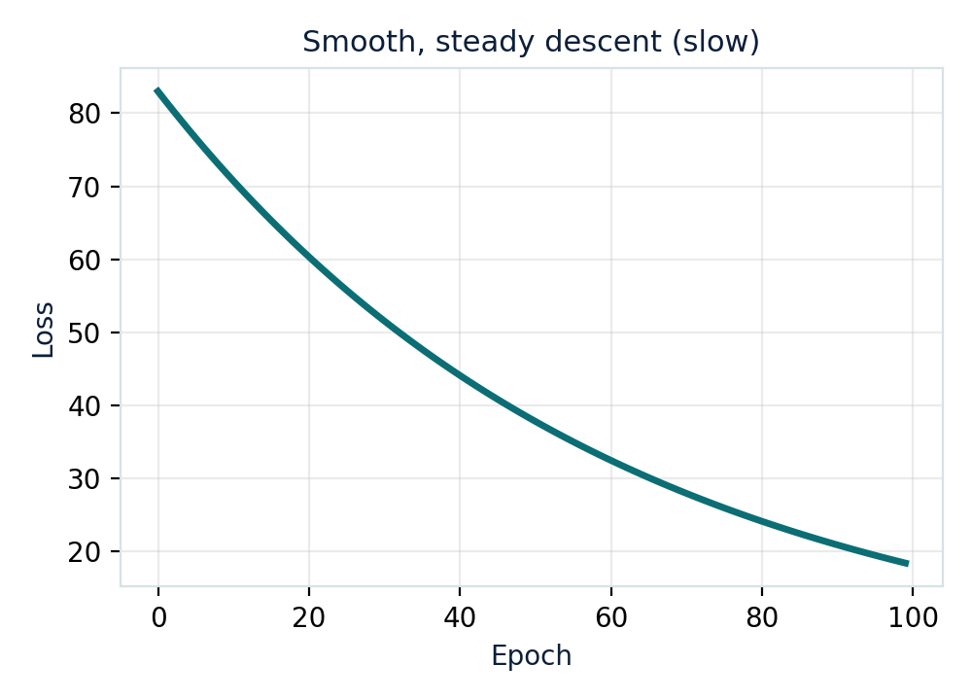
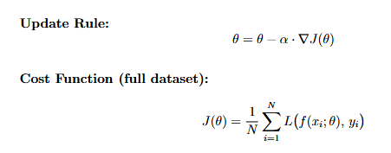
CORE ALGORITHM · 01
Batch Gradient Descent
Computes the gradient using the ENTIRE training dataset before making one weight update. One epoch = one update.
Full-dataset update — stable but slow
02

Slide 3
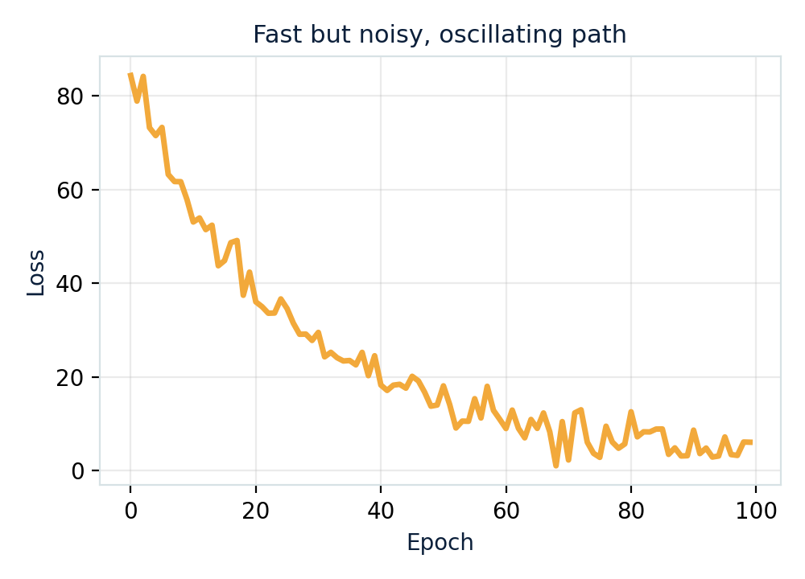
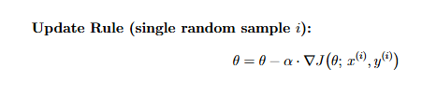
CORE ALGORITHM · 02
Stochastic Gradient Descent
Updates weights after computing the gradient from just ONE randomly chosen sample — N updates per epoch.
One-sample update — fast but noisy
03

Slide 4
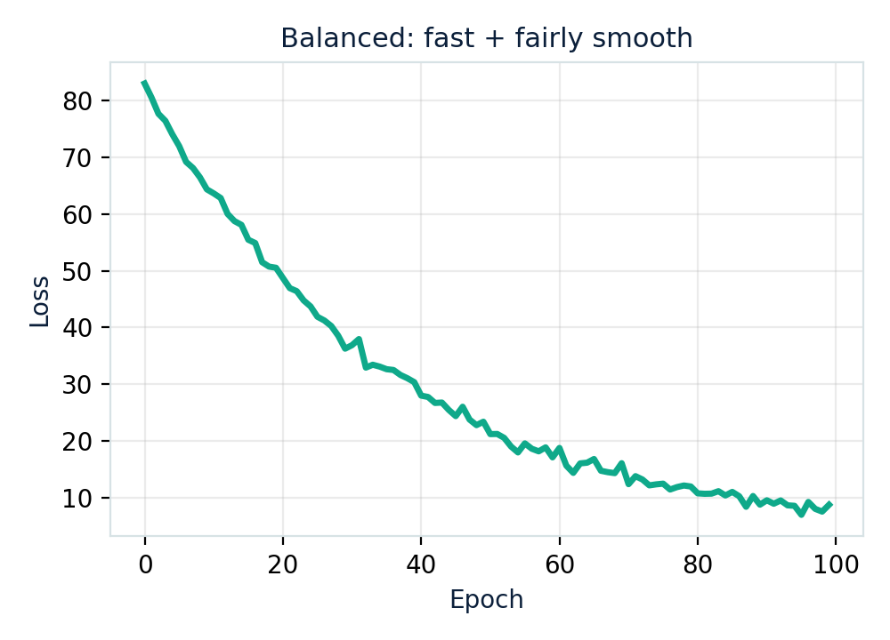
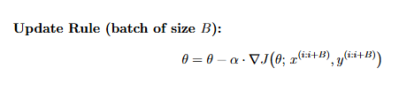
CORE ALGORITHM · 03
Mini-Batch Gradient Descent
Splits data into small batches (e.g. 32, 64) and updates after each batch — a balance between Batch and SGD.
Balanced approach — industry default
04

Slide 5
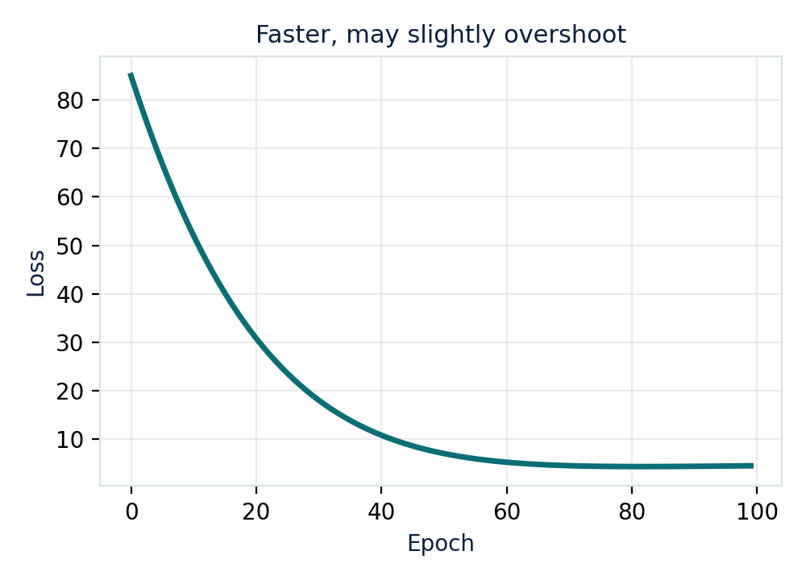
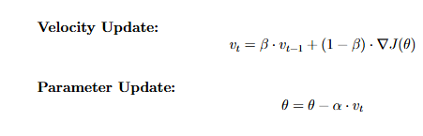
ADVANCED OPTIMIZER · 04
Momentum
Adds a velocity term that accumulates past gradients, keeping updates moving in a consistent direction.
Accelerated descent — like a rolling ball
05

Slide 6
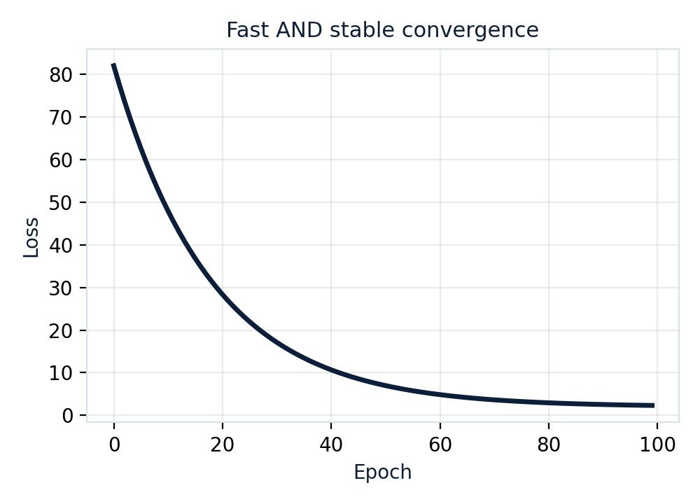
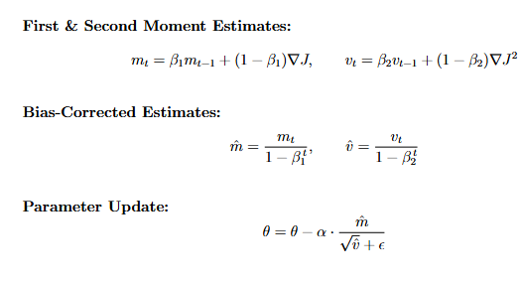
ADVANCED OPTIMIZER · 06
Adam Optimizer
Combines Momentum's velocity with RMSProp's adaptive scaling, plus bias correction — today's default optimizer.
Momentum + RMSProp — fast and stable
07

